Slide 1
Probabilistic Analysis of Structure
Group 3
Group member
Delos-Haoran Liang
Atom-Yatong Wu
Rick-Shoupei Wang

Slide 2
Contents
Background
Structural analysis(by Atom-Yatong Wu)
Structure layout
Loads
Displacement method
Probabilistic analysis(by Delos-Haoran Liang)
Uncertainties in capacities
Uncertainties in loads
Fragility analysis
Additional insight(by Rick-Shoupei Wang)
Expected losses
Measures to reduce the losses
Conclusion

Slide 3
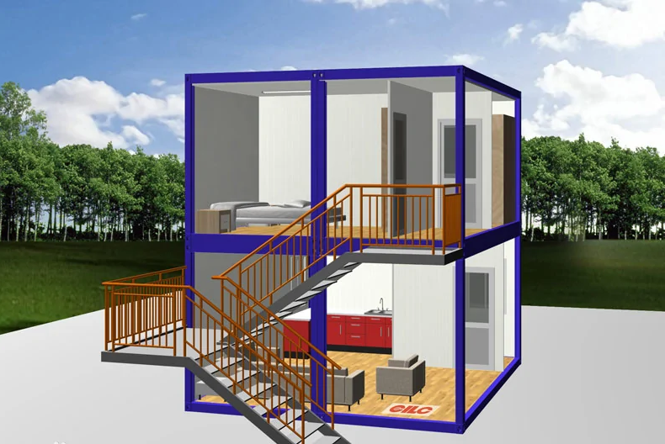

Background
In foreign countries, the idea of container house has been widely used.
A container can be transformed into a warm house with windows and doors after a little change.

Slide 4
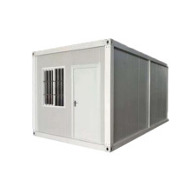
Background
Domestically, such containers are commonly used as dormitories for workers on construction sites.
inexpensive
sturdy and durable
construct easily
It is worth studying whether such buildings are safe in daily life and stable in windy weather. Therefore, we chose the most common container on the construction site as the research object for structural analysis and research.

Slide 5
Contents
Background
Structural analysis(by Atom-Yatong Wu)
Structure layout
Loads
Displacement method
Probabilistic analysis(by Delos-Haoran Liang)
Uncertainties in capacities
Uncertainties in loads
Fragility analysis
Additional insight(by Rick-Shoupei Wang)
Expected losses
Measures to reduce the losses
Conclusion

Slide 6
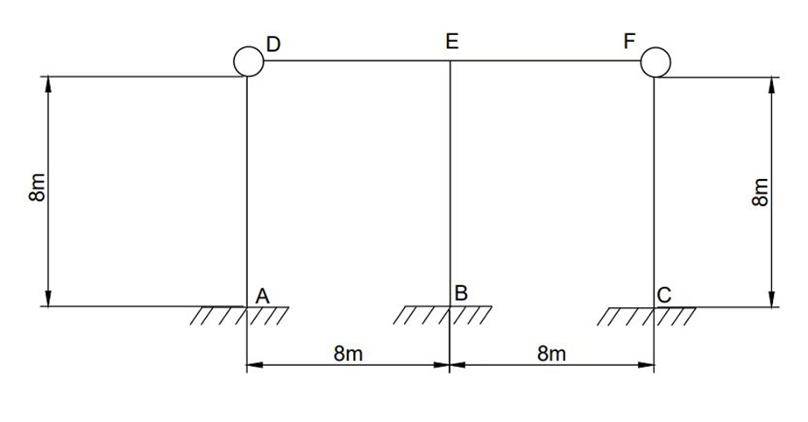
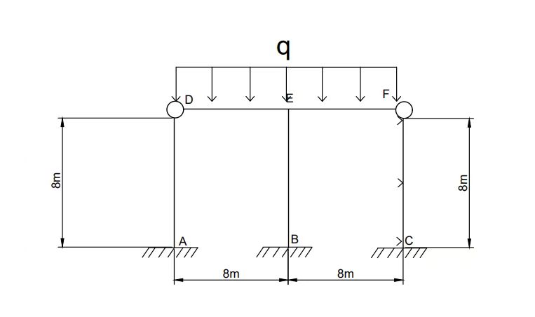
Structure layout & Load
Fig.1. Schematic
Fig. 2. Vertical uniform load
We assumed the element DF is loaded by a uniform load q and the length is L; A B C E node is the rigid joint; node D F is the hinge joint individually;
The structure have 3 superfluous constraint.

Slide 7
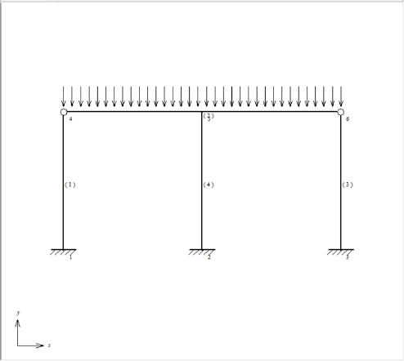
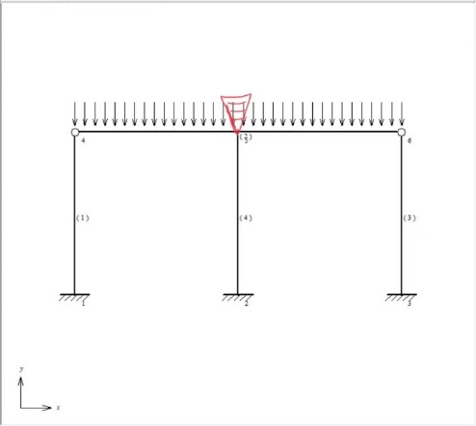
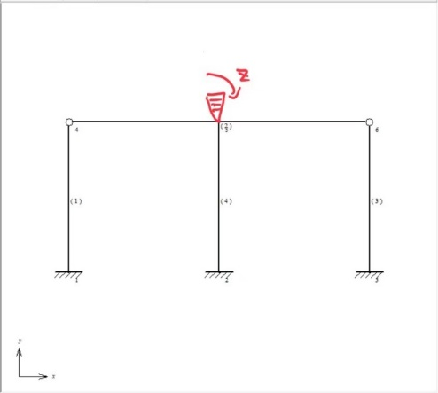
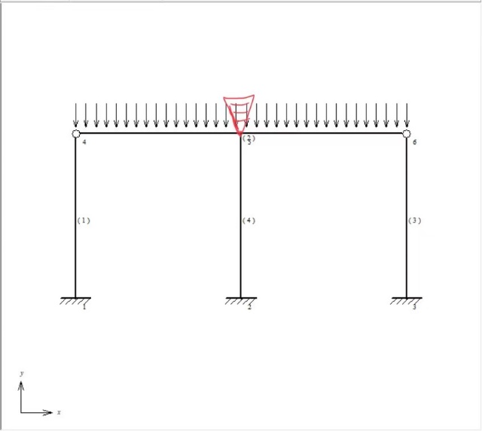
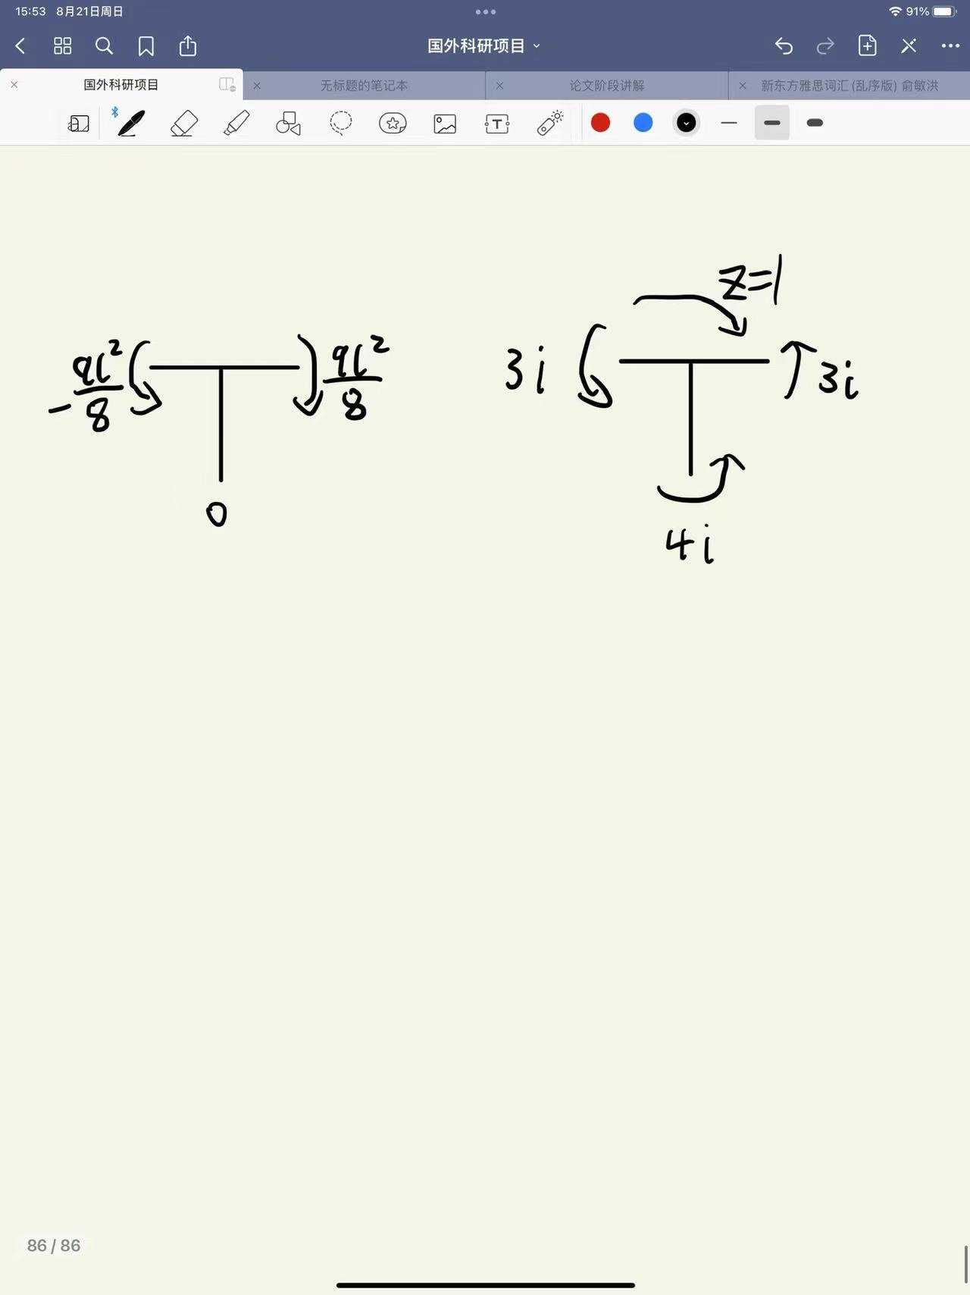
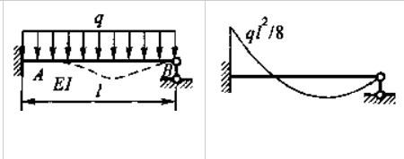
Displacement method
1. Fix the structure and then break it down
=
+
We can assume the angle is 1
2. Analyze the node E
We can look up in the table:

Slide 8
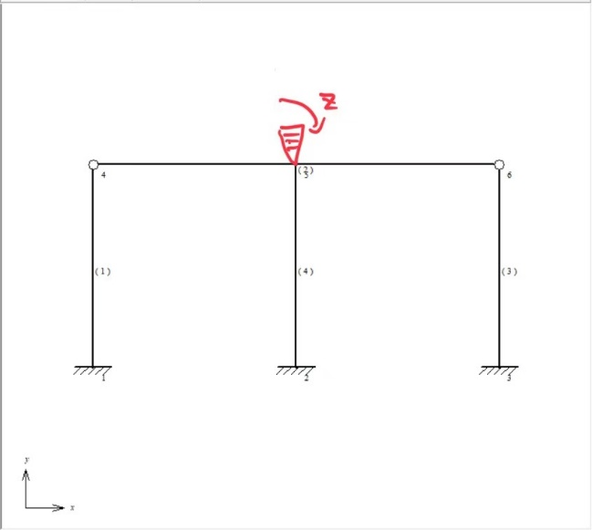
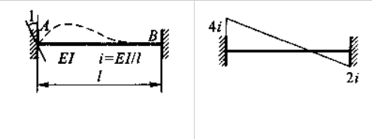
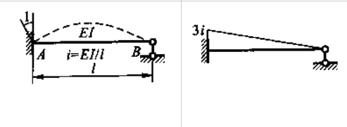
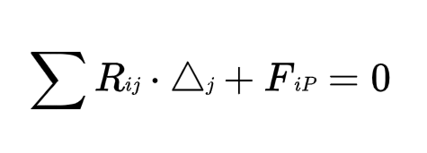
Displacement method
3. Analyze the node E
We can look up in the table:
4. Build the equation of displacement method

Slide 9
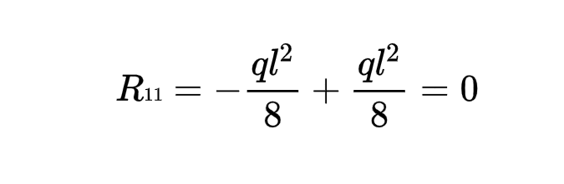
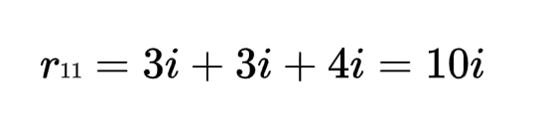
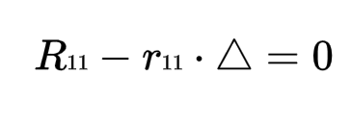
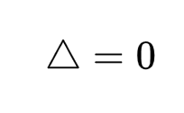
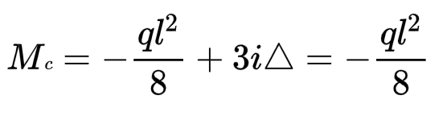
5. We can get:
6. Calculating the bending moment of the left side of node E

Slide 10
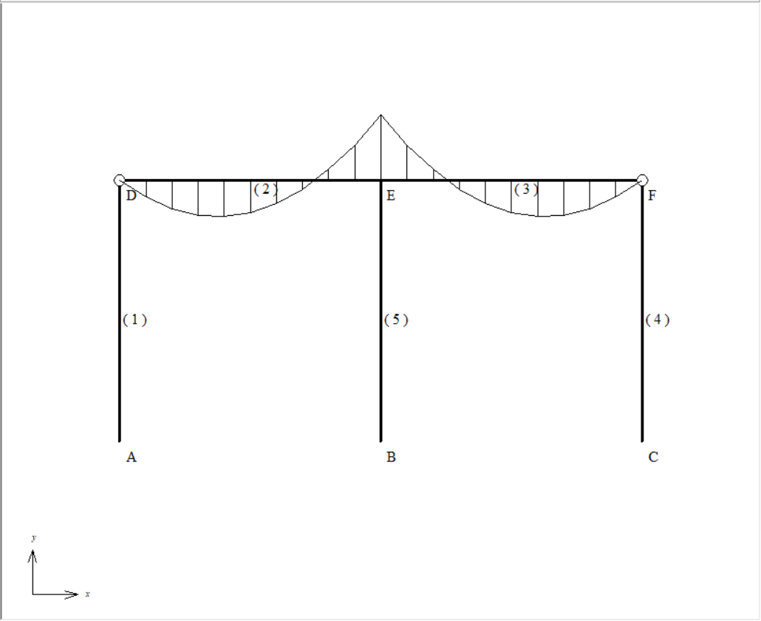
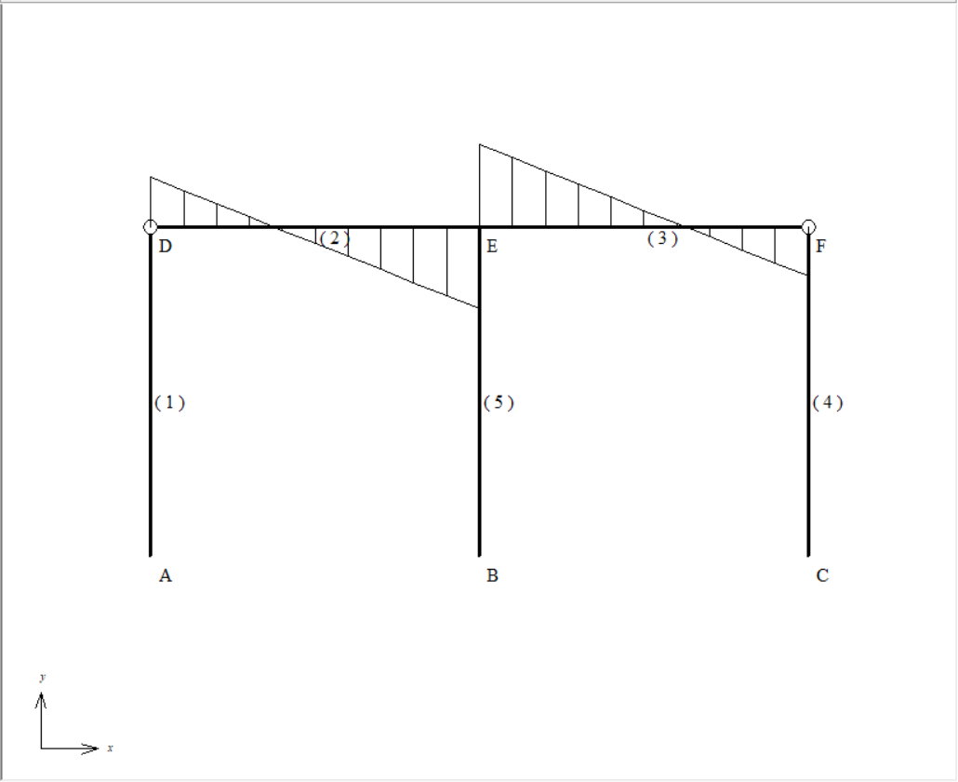
7. Draw the final internal force diagrams
(a) Bending moment diagram
(b) Shear force diagram
Fig. 3. Internal force diagrams

Slide 11
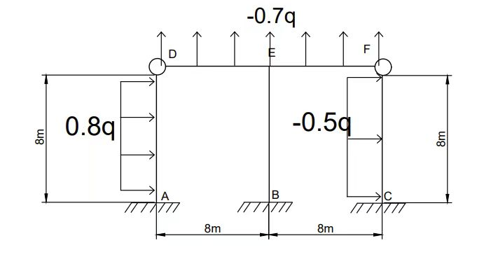
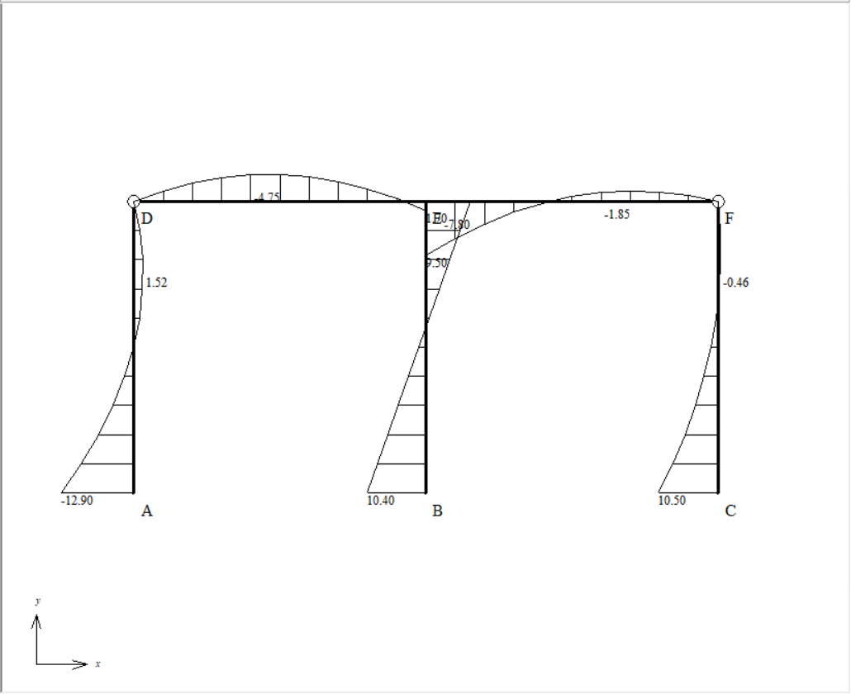
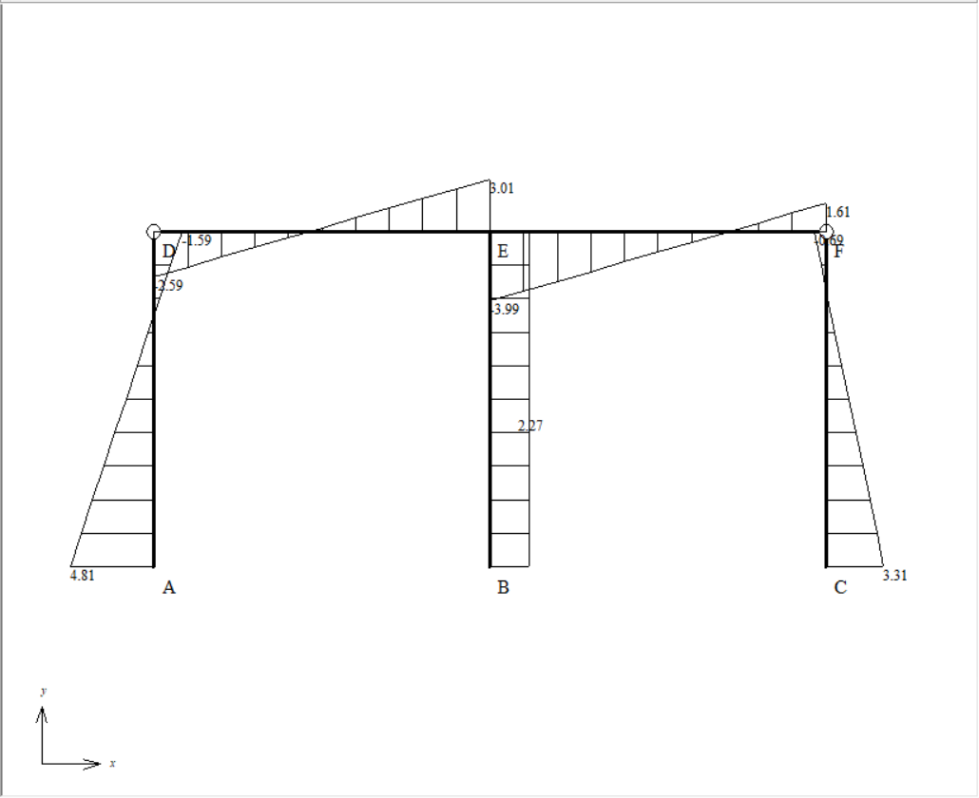
8. Draw the internal force diagrams when the structure is affected by a left wind
the structural analysis:
Fig. 4. Left wind load
(a) Bending moment diagram
(b) Shear force diagram
Fig. 5. Internal force diagrams

Slide 12
Contents
Background
Structural analysis(by Atom-Yatong Wu)
Structure layout
Loads
Displacement method
Probabilistic analysis(by Delos-Haoran Liang)
Uncertainties in capacities
Uncertainties in loads
Fragility analysis
Additional insight(by Rick-Shoupei Wang)
Expected losses
Measures to reduce the losses
Conclusion

Slide 13
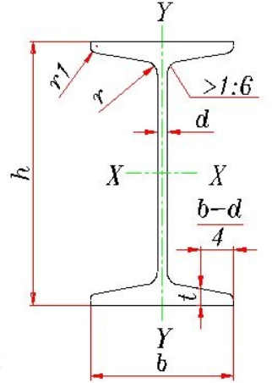
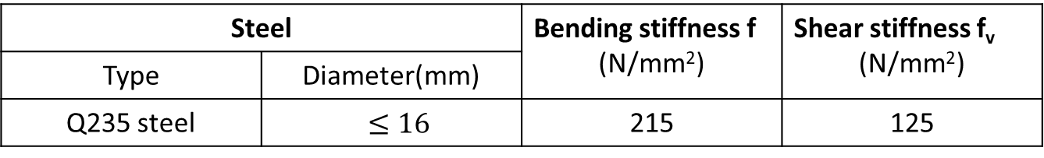
Uncertainties in capacities
Description
We select hot rolled ordinary I-beam of Q235 steel, this kind of I-beam is used for a column with a hinged upper end and a fixed one at the lower end, and the length of the column is 8m.
Size(mm) |  |  |  |  | cs-area (cm²) | x-x axis
h | b | d | t | R |  | W_{X} (cm³) | I_{X}/S_{X} (cm)
200 | 100 | 7.0 | 11.4 | 9.0 | 35.5 | 237 | 17.2
Table 1: Standard of I-beam
Steel |  | Bending stiffness f (N/mm²) | Shear stiffness f_{v} (N/mm²)
Type | Diameter(mm)
Q235 steel | $≤16$ | 215 | 125
Fig. 6. I-beam
Table 2: Strength design value

Slide 14
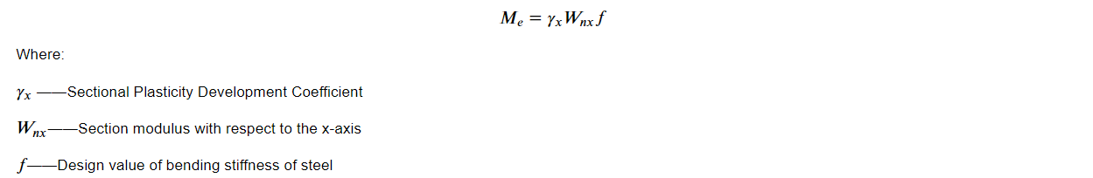
Description
1. According to our preliminary calculation, the maximum shear force loading on the structure is far smaller than the design
value of shear force, so we only took the bending failure into consideration.
2. We didn’t consider the destruction of the boards, and we assumed the loading on boards will transmit to the columns on
both sides uniformly.
3. The formula for calculating standard value of maximum bending moment is as follows(Chen & Gu, 2014):
M_{e} obeys Gamma Distribution(Smith, 2011), the related parameters are shown in Table 3.
random variable | mean | coefficient of variation(Liu, etc., 2020)
M_{e}(kN · m) | 53.503 | 0.016
Table 3: Parameters of Gamma Distribution

Slide 15
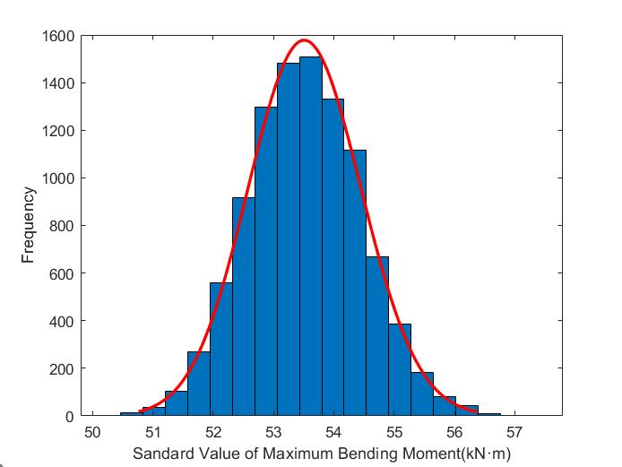
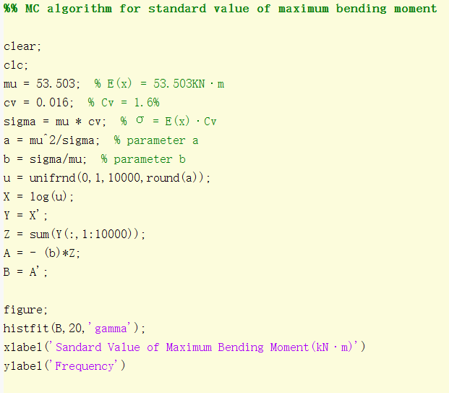
MC algorithm through MATLAB
Notation
N_{MC} number of Monte Carlo simulations
Fig. 7. MATLAB code for MC algorithm
Fig. 8. Histogram of frequency when N_{MC} = 10,000

Slide 16
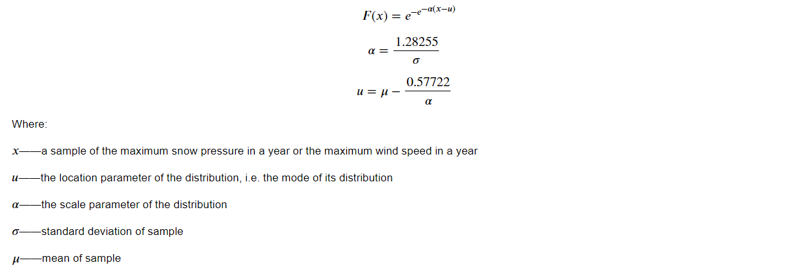
Uncertainties in loads
Description
According to Load Code for Building Structures (GB50009-2012) in China, the statistical samples of snow pressure and wind velocity obey the Extreme Value TypeⅠDistribution.
The distribution function of the snow pressure and wind velocity is as follows(GB50009-2012):

Slide 17
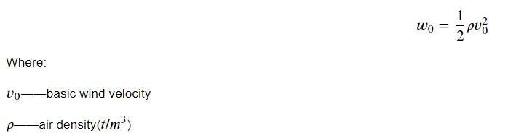

Description
1. To simplify our analysis, we ignore the loads caused by snow pressure and the dead weight of the structure, we will
only focus on the wind loads.
2. According to GB50009-2012, the wind loads are calculated by basic wind pressure $w$₀ which obeys a relationship
with basic wind velocity v₀:
GB50009-2012 only provides the data of basic wind pressure, so we assumed that basic wind pressure also obeys
Extreme Value TypeⅠDistribution, the related parameters are shown in Table 4.
random variable | mean(Peking, GB50009-2012) | coefficient of variation
$ω0$(kN / m²) | 0.5 | 0.01
Table 4: Parameters of Extreme Value TypeⅠDistribution

Slide 18

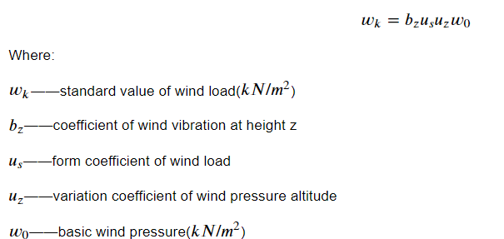
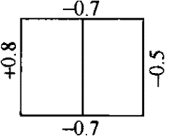
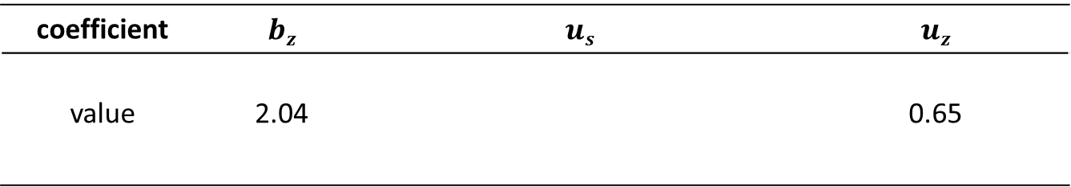
Wind Load
The formula for calculating wind load is as follows(GB50009-2012):
Given windward width of the structure B = 8m, we obtain the specific values of the structure according to GB50009-2012,
and we will put the detailed calculative process in our final written report, the values are shown in Table 5.
Fig. 9. Equivalent uniform load on our structure
coefficient | $$bz$$ | $$us$$ | $$uz$$
value | 2.04 |  | 0.65
Table 5: Values of coefficient

Slide 19
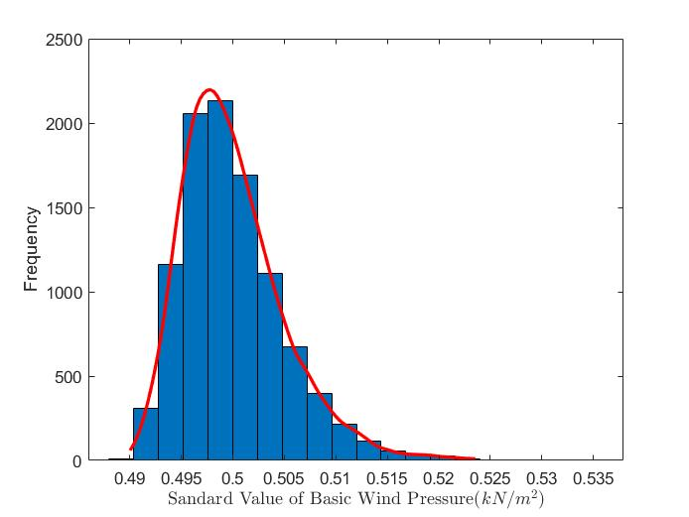
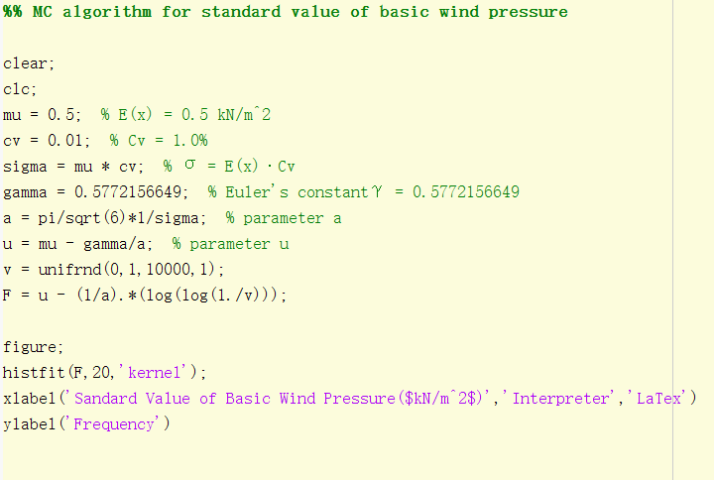
Wind Load
Fig. 10. MATLAB code for MC algorithm
Fig. 11. Histogram of frequency when N_{MC} = 10,000

Slide 20
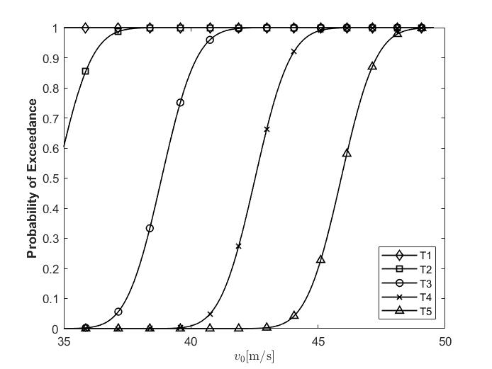
Fragility analysis
In Fig. 12 the dimensional displacement thresholds used in
this study(T1 to T5) were defined as a function of the building
width, variable between 0.012%B and 0.028%B(B = 8 m).
These thresholds, listed in Table 6, were selected as a first
attempt at defining appropriate and realistic limit states(e.g.,
Maximum lateral drift criterion)(Smith, 2011).
Table 6
Thresholds for use in the fragility analysis of our structure.
Label | Threshold level (mm)
T1 | 0.012%B = 0.96
T2 | 0.016%B = 1.3
T3 | 0.02%B = 1.6
T4 | 0.024%B = 1.9
T5 | 0.028%B = 2.2
Fig. 12. Example of structural fragility curves for uncertain
distribution of M_{e} as a function of the increased velocity.

Slide 21
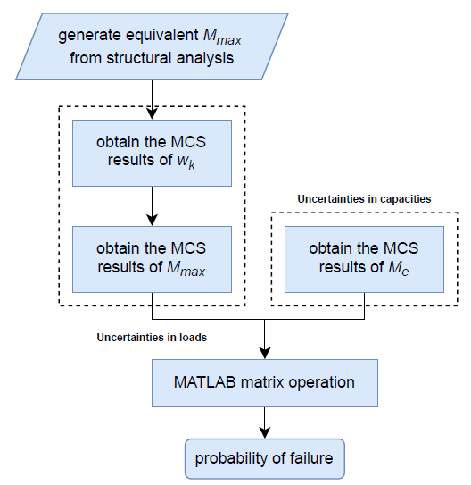
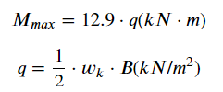
Probability of failure
Application of unit load method:
Fig. 13. Flow chart of the calculation of the P(Failure)
Fig. 14. Bending moment diagram (unit q kN · m)
point of bending failure

Slide 22
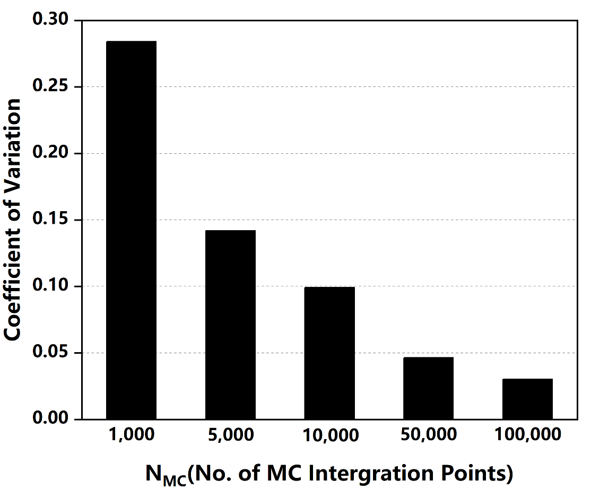
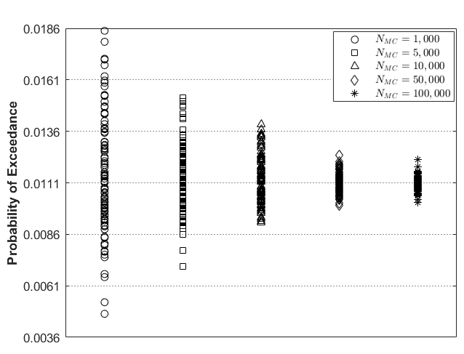
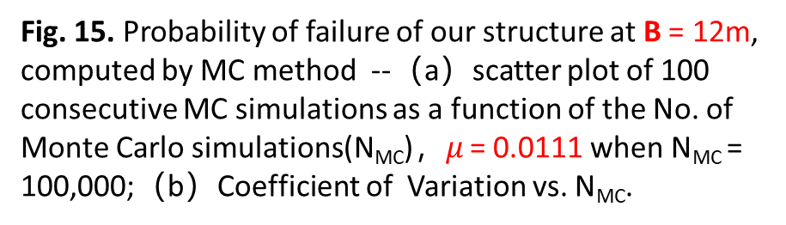
Probability of failure
b
a
Table 7
MC validation: run time vs. N_{MC}.
N_{MC} | Average relative run time ª
1,000 | 0.0097
5,000 | 0.0483
10,000 | 0.0965
50,000 | 0.4961
100,000 | 1.0000
Fig. 15. Probability of failure of our structure at B = 12m,
computed by MC method --（a）scatter plot of 100
consecutive MC simulations as a function of the No. of
Monte Carlo simulations(N_{MC})，$μ$ = 0.0111 when N_{MC} =
100,000;（b）Coefficient of Variation vs. N_{MC}.
ª Run time relative to N_{MC} = 100,000.

Slide 23
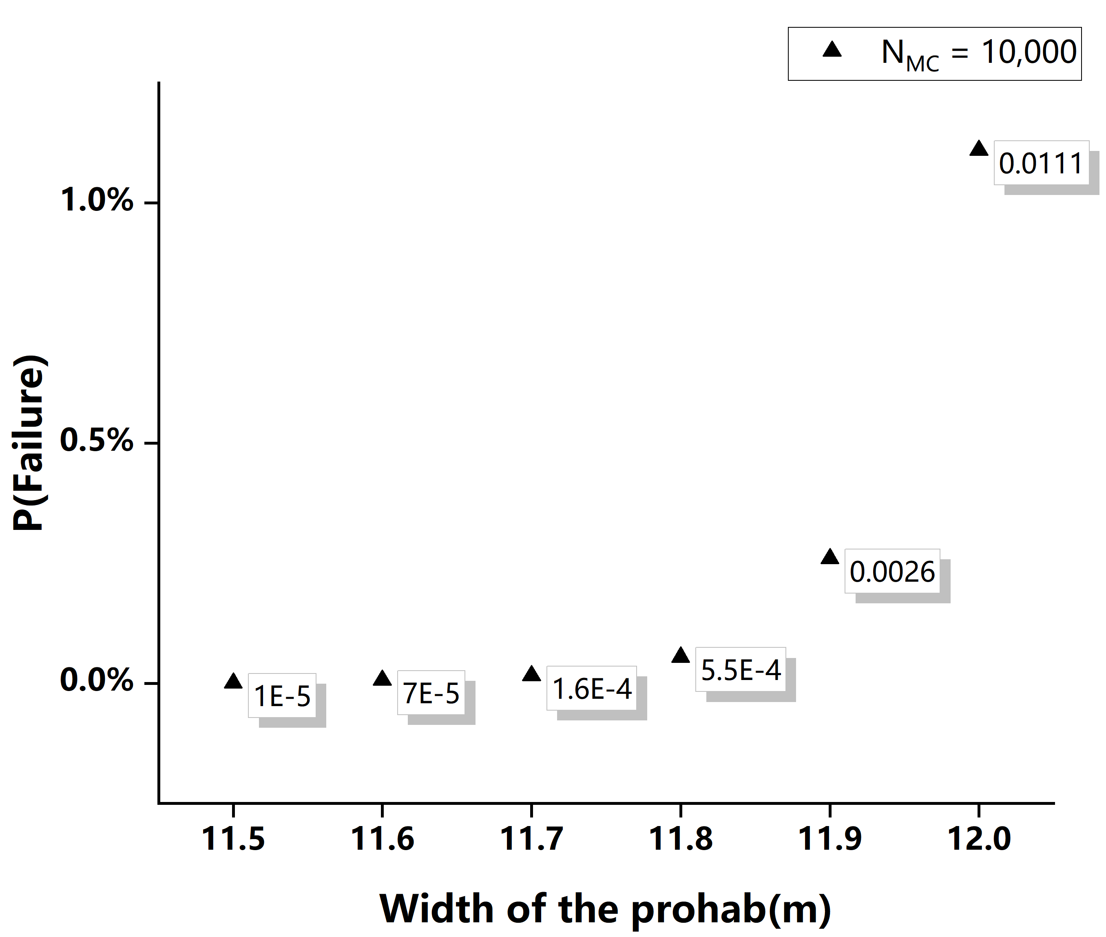

Suggestion for design value
Without additional support, the unit lode q is
proportional to the width B, so with the increase of B, the probability of failure rises respectively.
If the maximum tolerance of the P(Failure) = 0.01%,
then the theoretical threshold of the design value of the width will be 11.6m.
However, in fact, the realistic design value of the width of the type of our container is usually between
8m and 10m, due to the unpredictable uncertainties caused by manual manipulation especially when installing, so setting up the design value a bit less than the theoretical threshold can guarantee the safety to the utmost extent.
Fig. 16. Probability of failure as a function of the increased width
of the container when N_{MC} = 10,000.

Slide 24
Contents
Background
Structural analysis(by Atom-Yatong Wu)
Structure layout
Loads
Displacement method
Probabilistic analysis(by Delos-Haoran Liang)
Uncertainties in capacities
Uncertainties in loads
Fragility analysis
Additional insight(by Rick-Shoupei Wang)
Expected losses
Measures to reduce the losses
Conclusion

Slide 25
Additional insight
Expected loss: the loss of construction refers to the loss of value caused by the diminishing utility of buildings due to various reasons during the using of buildings (Shen, 2001).
Material loss
Energy loss, material loss (concrete, steel), structure damage
Expected loss
Invisible waste
Economic loss, space waste
Building loss is an important problem in building construction. And reasonable estimation of loss can effectively prolong the lifespan of buildings and save energy to achieve sustainability(Zeng, 2012).

Slide 26
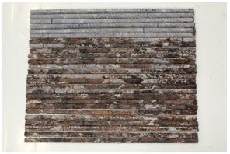
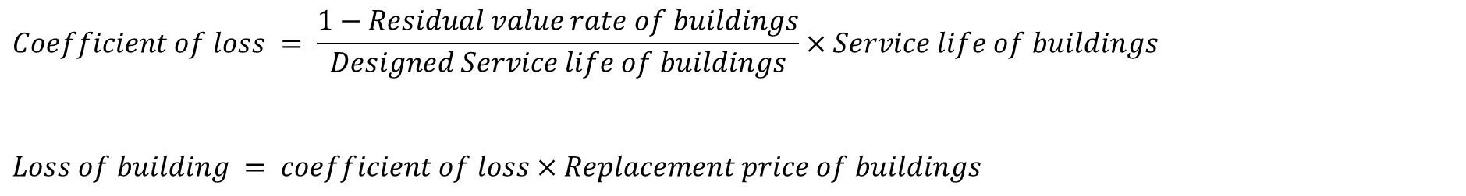
Expected loss in the structure
Material factors: Dimensional error of steel, corrosion of steel
Economic factors: Changes in material prices, reduced utilization of space
Determination of building loss (Gao, Zhang, 2021):
Fig. 17. Corrosion of steel
$$Coefficient of loss = \frac{1−Residual value rate of buildings}{Designed Service life of buildings}×Service life of buildings$$
$$Loss of building = coefficient of loss×Replacement price of buildings$$

Slide 27
Measures to reduce the losses
Protection of Steel——Anti-rust paint
TN-922G (Specially developed for long-term exposed steel) (Ye,2012)
The material is made of inorganic cementitious materials and non-toxic polymer additives.
Properties:
Non-toxic
Tasteless
Non combustible
Nonvolatile
Corrosion resistance
Strong sealing
Simple operation
No special maintenance needed
Preparation of equipment
Spray sand and clean rust
Surface treatment with wire brush
Blending coating
Brushing
Fig. 18. Workflow

Slide 28
Measures to reduce the losses
Refined management to reduce the loss of steel (Bi, Ye, 2014)
Build backstage steel management system.
Build using scattered material management system.
Build accountability system.
Economic measures

Slide 29
Contents
Background
Structural analysis(by Atom-Yatong Wu)
Structure layout
Loads
Displacement method
Probabilistic analysis(by Delos-Haoran Liang)
Uncertainties in capacities
Uncertainties in loads
Fragility analysis
Additional insight(by Rick-Shoupei Wang)
Expected losses
Measures to reduce the losses
Conclusion

Slide 30
Conclusion
Related areas
Structural analysis: Structural mechanics, Material mechanics
Probabilistic analysis: Probability Theory, Numerical analysis
Additional insight: Material Science, Engineering Management
Strengths
Visualization: To the best of our knowledge, we utilize MATLAB and Origin to perform our results, which are
generally thought to be precise and intuitive.
Simpleness & Effectiveness: We build a simple and effective methodology without considering all the details
of the structural and probabilistic analysis.
Weakness
Missing the consideration of the combination of the influences by all possible loads.

Slide 31
Reference list
Chen Shaofan, Gu Qiang. Steel structure foundation[M].Peking: China Architecture & Building Press, 2014.48-51.
Liu Jiaxing, Li Yeping, and Xie Xianjiao. Evaluation of Uncertainties in Tensile Strength Measurement of Q235 Steel. Physical and Chemical Inspection-Physical Volume 56.6(2020):27-28.
Ministry of Construction, PRC. “GB50009-2012, Load Code for Building Structures.”(2012).
Smith, Marra A. , and Luca Caracoglia. “A Monte Carlo based method for the dynamic “fragility analysis” of tall buildings under
turbulent wind loading.” Engineering Structure 33.2(2011): 410-420.
Shen Liangfeng. Using Fuzzy Theory Determine the Proportion of Building Damage. J.OF Wuhan Urban Construction On Institute Vol.18 No.2 Jun.2002
Zeng Miaoxin. Optimize Building Construction Techniques to Reduce Building Energy Loss. Private Science and Technology. 43.8(2012):313
Gao Xiaolou, Zhang Ting. Construction Materials Management Method Based on BIM. Engineering management. 12(2012):105-106
Ye Jinfeng. Study on Anticorrosion Technology of Long-term Exposed Rebar. China Three Gorges Construction. 06(2016):20-21

Slide 32
Thanks for Listening

